Slide 1

Customer Feedback Analysis and Improvement
Analyze Feedback, Improve Products.
By: Group1 CAI1_AIS4_S3e
GitHub

Slide 2

Week 1: SQL Database Setup
1
Python Processing
Utilize Python libraries like Pandas for data cleaning and preprocessing. This step involves handling missing values, transforming data types, and removing irrelevant information to prepare the data for analysis.
2
Database Design
Create tables to capture customer feedback, including details like feedback type, product, date, and specific comments.
3
Database Setup
Choose an appropriate database management system (DBMS) for your needs, like MySQL or PostgreSQL. Define the schema and set up the database structure.
4
Data Collection
Develop a process to import customer feedback data from various sources like surveys, reviews, and support tickets. Transform the data into a consistent format for analysis.
GitHub

Slide 3
Week 2: Data Warehouse and Python
Data Warehouse
Data Integration
SQL Queries
Aggregate customer feedback data from various sources into a central repository. This warehouse will serve as a single source of truth for our analysis, ensuring consistency and reliability of the data.
Load the cleaned and preprocessed data into the data warehouse using Python and appropriate database connectors. This involves setting up connections between the data source, the processing environment, and the warehouse for seamless data flow.
Write SQL queries to analyze the data, extracting key insights like common themes, sentiment scores, and product-specific issues. Utilize functions and aggregations for effective data exploration.
GitHub

Slide 4
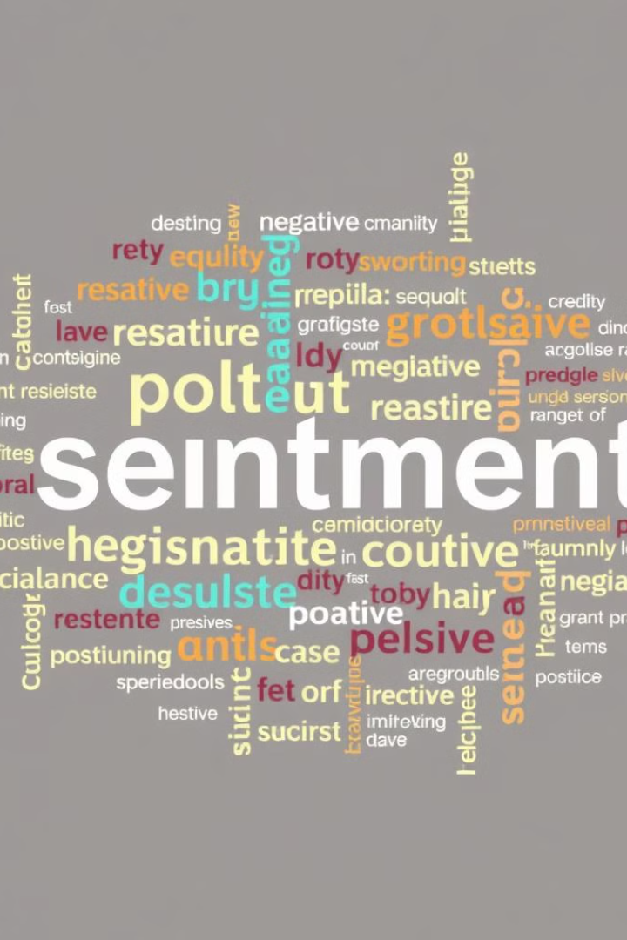
Week 3: Sentiment Analysis and Azure
1
Sentiment Analysis Overview
Objective: Classify Amazon reviews as positive, neutral, or negative.
Dataset: 1.5 million Amazon reviews.
Sentiment Mapping: Positive: Star rating ≥ 4 and Neutral: Star rating = 3. and Negative: Star rating ≤ 2
2
Data Preparation and Vectorization
Data Preparation: Convert ratings to sentiment (Positive = 1, Negative = 0). And Remove neutral reviews.
Text Vectorization: Method: TF-IDF (Term Frequency-Inverse Document Frequency) and Max Features: 10,000
Train-Test Split: Training Set: 80%Testing Set: 20%
3
Model Implementation and Evaluation
Models Used: 1-Logistic Regression. 2-Naive Bayes. 3-Decision Trees.
Conclusion: Compare model performance and overall effectiveness.
GitHub

Slide 5
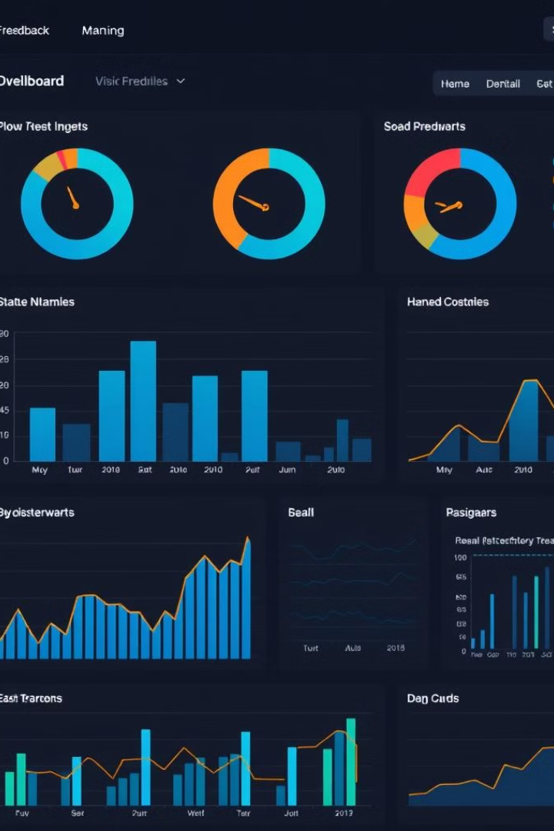

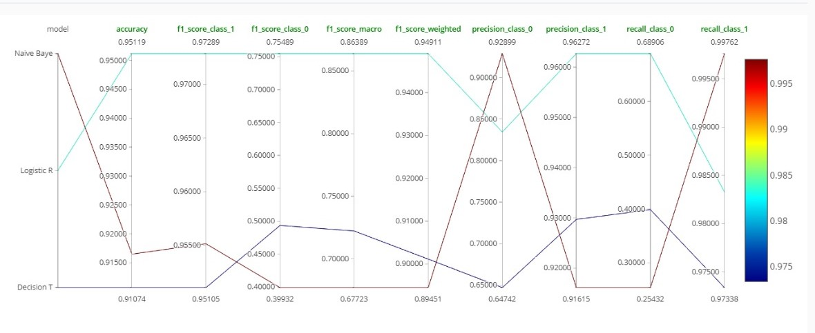


Week 4: MLOps and Final Presentation
MLflow Logging
Tracking Setup: Connected to MLflow tracking server.
Experiment: “Sentiment Analysis Models Comparison” tracked all models.
Metrics Logged: Accuracy, Precision, Recall, F1-Scores (for both positive and negative sentiment). Macro & Weighted F1-Scores for aggregate performance.
Models Evaluated
Logistic Regression: 1- Accuracy: 95.12% 2- Observation: Best overall performance, high accuracy for positive sentiment but lower recall for negative sentiment.
Naive Bayes: 1- Accuracy: 91.65% 2- Observation: Biased towards positive sentiment, poor recall (25.43%) for negative reviews.
Decision Trees: 1- Accuracy: 91.07% 2- Observation: Balanced but weaker in predicting negative reviews (40% recall).
Best Model
Logistic Regression – Achieved the highest accuracy and was most effective at positive sentiment prediction
GitHub

Slide 6

Conclusion
This Concludes Our Journey Through Customer Feedback Analysis and Improvement.
We’ve Explored Data Collection, Warehouse Setup, Sentiment Analysis, and MLOps Implementation.

